Slide 1
Basics of Git and Github

Slide 3
Prerequisites
A GitHub account

Slide 4
Learning objectives
Open a repo using GitHub.dev
Create a branch
Commit changes to the branch
Create a pull request
Merge the pull request
Delete the branch

Slide 5
Agenda
Introduction
What is GitHub?
Work in GitHub.dev
Quiz
Summary

Slide 6
Introduction
You don’t need any programming knowledge Any one can use git and github

Slide 7
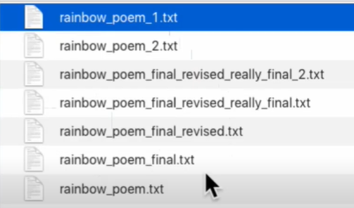
What is the use of Git and Github?
It stores the versions of the file or tracks the entire history of changes that you had made to that file

Slide 8
Introduction
GitHub is a development platform that enables you to host and review code, manage projects, and build software alongside 50 million developers.
Notes:
GitHub is a development platform that enables you to host and review code, manage projects, and build software alongside 50 million developers.
Why is everyone building on GitHub? Because it provides the important DevOps features companies and organizations of all sizes need for their public and private projects. Whether it's planning features, fixing bugs, or collaborating on changes, GitHub is the place where the world's software developers gather to make things. And then make them better.
In this module, you learn to use key GitHub features, including issues, notifications, branches, commits, and pull requests.

Slide 9

GitHub: An Overview of the Platform
GitHub is one of the most popular platforms for Version Control.
If Git is the ingredient, GitHub is the final product.
Largest hub of open-source software.
Github’s Logo – The Octocat
Notes:
So Github is basically a platform for developers to store their code in an organized manner. It can also be used as a collaborative tool for developers to reach out to other developers and collaborate on their projects. Git allows you a tree like structure where by default everything is stored in a branch called “master” and you can create as many branches as you like. Now that we’re talking about branches, why do we need branches? It’s kind of an extra security feature so that someone doesn’t accidentally make changes to the master branch (which is the main branch). Also, if you want to contribute to someone else’s project, it is good practice to create a new branch and make your edits over there.

Slide 10
Difference beteen git and github
Github
Git
Version control system
Version control system
Works locally on the system(laptop)
Works in any web apps

Slide 11
Important Terms
Repository(project Folder) =>consists of files of the project
commit =>saves the changes made to file of the project
Readme File =>Instruction file for the repo

Slide 12
What is GitHub?

Slide 13
Open-Source Contributions
A software for which the original source code is made freely available and maybe redistributed and modified according to the requirement of user is known as Open Source softwares and the developers who are contributing to these types of projects are called Open-Source Contributors.

Slide 14
Some famous Open-Source Projects
Apache Cassandra
TensorFlow
Kubernetes
Ansibl
Mozilla
RedHat etc. etc.

Slide 15
Why contribute ??
Improve software you rely on
Improve existing skills
Find mentors
Meet peoples who are interested in similar things
Learn people skills

Slide 16
The GitHub flow
In addition to providing a platform for collaborative software development, GitHub also offers a workflow designed to optimize use of its various features.
Notes:
In addition to providing a platform for collaborative software development, GitHub also offers a workflow designed to optimize use of its various features. While this unit offers a cursory overview of important platform components, it's recommended that you first review Understanding the GitHub flow.

Slide 17
Git and GitHub
As you work with Git and GitHub, you may wonder about the difference between the two.
Issues
Discussions
Pull requests
Notifications
Labels
Actions
Forks
Projects
Installed and used on your local machine
Handles version control
Supports branching
Notes:
As you work with Git and GitHub, you may wonder about the difference between the two.
Git is a distributed version control system (DVCS) that allows multiple developers or other contributors to work on a project. It provides a way to work with one or more local branches and push them to a remote repository. Git is responsible for everything GitHub-related that happens locally on your computer. Key features provided by Git include:
Installed and used on your local machine
Handles version control
Supports branching
To learn more about Git, see Using common Git commands.
GitHub is a cloud platform that uses Git as its core technology. It simplifies the process of collaborating on projects and provides a website, command-line tools, and overall flow that allows developers and users to work together. GitHub acts as the "remote repository" mentioned previously in the Git section.
Key features provided by GitHub include:
Issues
Discussions
Pull requests
Notifications
Labels
Actions
Forks
Projects
To learn more about GitHub, see Getting started with GitHub.

Slide 18
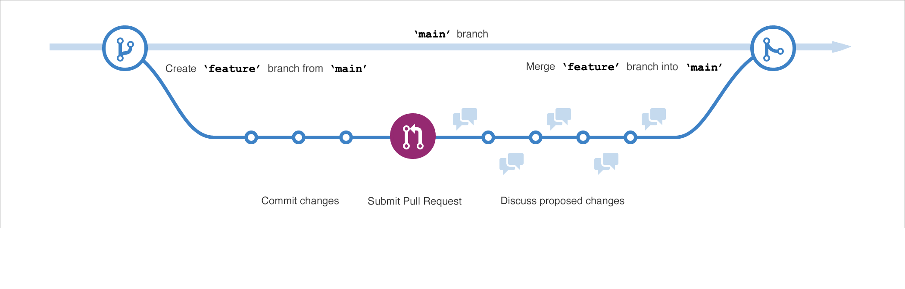
Branches
Branches are the preferred way to create changes in the GitHub flow.
Notes:
Branches are the preferred way to create changes in the GitHub flow. They provide isolation so that multiple people may simultaneously work on the same code in a controlled way. This model enables stability among critical branches, such as main, while allowing complete freedom for developers to commit any changes they need to meet their goals. Once the code from a branch is ready to become part of the main branch, it may be merged via pull request.
To learn more about GitHub branches, see About branches.

Slide 19
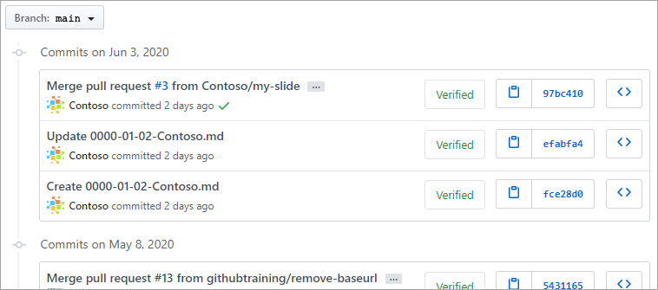
Commits
A commit is a change to one or more files on a branch.
Notes:
A commit is a change to one or more files on a branch. Every time a commit is created, it is assigned a unique ID and tracked, along with the time and contributor. This provides a clear audit trail for anyone reviewing the history of a file or linked item, such as an issue or pull request.
To learn more about GitHub commits, see Committing and reviewing changes to your project.

Slide 20
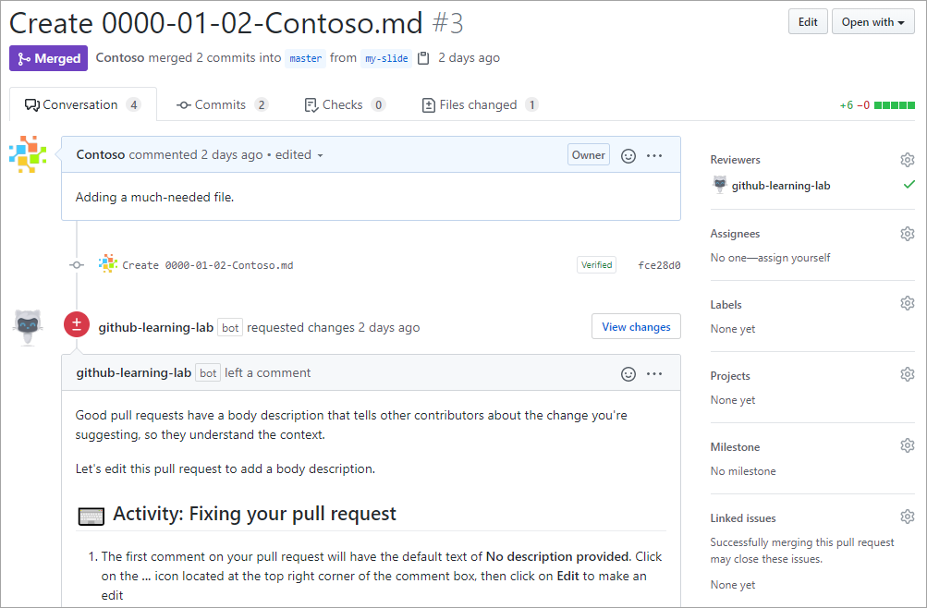
Pull Requests
A pull request is the mechanism used to signal that the commits from one branch are ready to be merged into another branch.
Notes:
A pull request is the mechanism used to signal that the commits from one branch are ready to be merged into another branch. The developer submitting the pull request will often request one or more reviewers to verify the code and approve the merge. These reviewers have the opportunity to comment on changes, add their own, or use the pull request itself for further discussion. Once the changes have been approved (if approval is required), the pull request's source branch (the compare branch) may be merged in to the base branch.
To learn more about GitHub pull requests, see About pull requests.

Slide 21
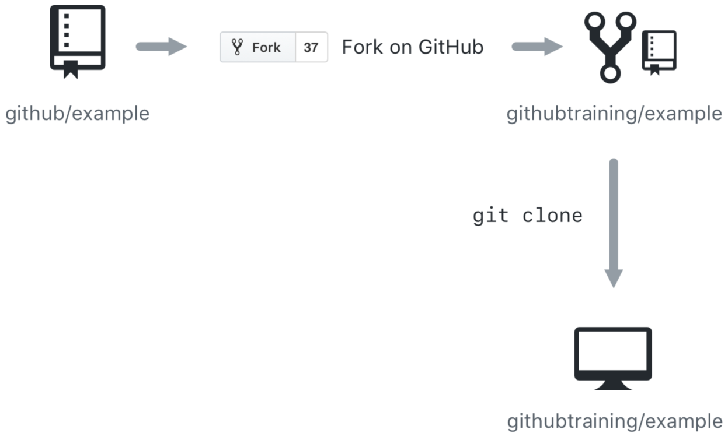
Cloning and forking
GitHub provides multiple ways to copy a repository so that you can work on it.
Cloning a Repository - Cloning a repository will make a copy of the repository and its history on your local machine. If you have write access to the repository you can push changes from your local machine to the remote repository (called the origin) as they're completed. To clone a repository you can use the git clone [url] command or the GitHub CLI's gh repo clone [url] command.
Forking a Repository - Forking a repository makes a copy of the repository in your GitHub account. The parent repository is referred to as the upstream while your forked copy is referred to as the origin. Once you've forked a repository into your GitHub account you can clone it to your local machine. Forking allows you to freely make changes to a project without affecting the original upstream repository. To contribute changes back to the upstream repository you create a pull request from your forked repository. You can also run git commands to ensure that your local copy stays synced with the upstream repository.
Notes:
GitHub provides multiple ways to copy a repository so that you can work on it.
Cloning a Repository - Cloning a repository will make a copy of the repository and its history on your local machine. If you have write access to the repository you can push changes from your local machine to the remote repository (called the origin) as they're completed. To clone a repository you can use the git clone [url] command or the GitHub CLI's gh repo clone [url] command.
Forking a Repository - Forking a repository makes a copy of the repository in your GitHub account. The parent repository is referred to as the upstream while your forked copy is referred to as the origin. Once you've forked a repository into your GitHub account you can clone it to your local machine. Forking allows you to freely make changes to a project without affecting the original upstream repository. To contribute changes back to the upstream repository you create a pull request from your forked repository. You can also run git commands to ensure that your local copy stays synced with the upstream repository.
When would you clone a repository versus fork a repository? If you're working with a repository and have write access you can clone it to your local machine. From there you can make modifications and push your changes directly to the origin repository.
If you need to work with a repository created by another owner such as github/example and don't have write access, you can fork the repository into your GitHub account, and then clone the fork to your local machine. To see this visually, let's assume that your GitHub account is called githubtraining for this example. Using the GitHub website you can fork githubtraining or any other examples into your account. From there you can clone the forked version of the repository to your local machine. These steps are shown in the following image.
Changes can be made to your local copy of githubtraining/example and then pushed back to your remote origin repository (githubtraining/example). The changes can then be submitted to the github/example upstream repository using a pull request as shown next.
To learn more, see Fork a repo.

Slide 22
Workshop walk-through
Fork a repo, create a branch, make a change, push it, delete branch

Slide 23
Quiz

Slide 24
Question 1
What is the best way to report a bug to a GitHub project?
Send an email to a project owner.
I don't bother reporting software bugs because there's no transparency and they never get fixed anyway.
Search for the bug in the project's existing issues and create a new one if it hasn't been reported yet.
Notes:
Explanation: A project's issues are visible to anyone who has access to the project, so you may find a resolution is already planned or available. Otherwise, you can create and track the issue yourself.

Slide 25
Question 1
What is the best way to report a bug to a GitHub project?
Send an email to a project owner.
I don't bother reporting software bugs because there's no transparency and they never get fixed anyway.
Search for the bug in the project's existing issues and create a new one if it hasn't been reported yet.
Notes:
Explanation: A project's issues are visible to anyone who has access to the project, so you may find a resolution is already planned or available. Otherwise, you can create and track the issue yourself.

Slide 26
Question 2
Suppose you have created a bug fix on a new branch and want it to become part of the next production build generated from the `main` branch. What should you do next?
Copy your branch changes and commit them directly to the `main` branch.
Create a pull request to merge your new branch into the `main` branch.
On second thought, maybe I won't share this fix. I'll just put it in my own private version of the source code.
Notes:
Explanation: Pull requests are the correct way to communicate that commits are ready for review and ultimate inclusion on the `main` branch.

Slide 27
Question 2
Suppose you have created a bug fix on a new branch and want it to become part of the next production build generated from the `main` branch. What should you do next?
Copy your branch changes and commit them directly to the `main` branch.
Create a pull request to merge your new branch into the `main` branch.
On second thought, maybe I won't share this fix. I'll just put it in my own private version of the source code.
Notes:
Explanation: Pull requests are the correct way to communicate that commits are ready for review and ultimate inclusion on the `main` branch.

Slide 28
Question 3
Suppose you'd like to work with a project on GitHub but you don't have write access to the project. What can you do to contribute?
Fork the project's repository to your GitHub account, clone the forked repository to your local machine, push changes to your repository, and submit a pull request to the target (upstream) repository.
Clone the project to your local machine and push updates directly to the project repository.
Use git commands to make a copy of the project so that you can work locally. Submit an issue to get your changes into the target repository.
Notes:
Explanation: GitHub provides forking functionality designed to allow you to work with projects where you aren't an owner or don't have write access. Forking makes a remote copy of the project in your repository that you can then clone locally. To submit updates to the target repository (upstream repository) you can submit a pull request.

Slide 29
Question 3
Suppose you'd like to work with a project on GitHub but you don't have write access to the project. What can you do to contribute?
Fork the project's repository to your GitHub account, clone the forked repository to your local machine, push changes to your repository, and submit a pull request to the target (upstream) repository.
Clone the project to your local machine and push updates directly to the project repository.
Use git commands to make a copy of the project so that you can work locally. Submit an issue to get your changes into the target repository.
Notes:
Explanation: GitHub provides forking functionality designed to allow you to work with projects where you aren't an owner or don't have write access. Forking makes a remote copy of the project in your repository that you can then clone locally. To submit updates to the target repository (upstream repository) you can submit a pull request.

Slide 30
Summary

Slide 31
Summary
In this module, you learned about the key features of GitHub and how to use it with GitHub.dev, including commits, branches, and pull requests.
Notes:
In this module, you learned about the key features of GitHub, including issues, commits, and pull requests. You also used GitHub Pages to publish a public site based on the contents of your project.
You learned about:
Communicating with the project community in issues
Managing notifications for project events
Creating branches to manage work in parallel
Making commits to update project source
Introducing changes with pull requests
Deploying a web page to GitHub Pages
Differences between Git and GitHub and the roles they play in the software development lifecycle
How a repository fork differs from a clone
Repository labels and where to apply them in issues and pull requests
Now that you're familiar with the basics of GitHub, learn to Upload your project by using GitHub best practices.

Slide 32
Learn more
Here are some links to more information on the topics we discussed in this module.
Setting up and managing organizations and teams
Committing changes to your project
Collaborating with issues and pull requests
About the role of labels
GitHub Actions
Fork a repo
Working with GitHub Pages
Please tell us how you liked this workshop by filling out this survey:
https://aka.ms/workshopomatic-feedback
Notes:
Here are some links to more information on the topics we discussed in this module.
Setting up and managing organizations and teams
Committing changes to your project
Collaborating with issues and pull requests
About the role of labels
GitHub Actions
Fork a repo
Working with GitHub Pages

